Slide 1


Slide 2

Personal Weapons
Instructor:
Date:

Slide 3
OBJECTIVES
Topic: Personal Weapons
Objectives: (Classroom)
  To understand and be able to execute defenses with personal weapons
  Understand the difference between stuns and strikes
  Use of Force Context

Slide 4
OBJECTIVES
Topic: Personal Weapons
Objectives: (Practical)
  To understand the 4 distances we deal with subjects in
  To execute strikes (palm heel, jab, cross, hook, elbows and forearms)
  To execute kicks (knees, rear leg front kick, lead leg front kick, angle kicks)
  How to strike with a weapon (baton / firearm) in your hand

Slide 5
OBJECTIVES
Method Of Instruction: Lecture development, practical application, written exam
Training Aides: Strike shields, boxing gloves, headgear, focus pads
Pen and paper are required

Slide 6
Introduction
  Sometimes officers are spontaneously attacked
  Personal weapons allow officers to deal with a multitude of situations by utilizing different parts of our body as striking surfaces
  Dependent on the situation, we can vary the level of force used by selection of targets and choice of strikes (low to high resistance levels)

Slide 7
Characteristics
  Personal Weapons include, but are not limited to:
  Front / back of the head
  Elbows / forearms
  Outside, palm, heel & fingers of the hand
  Knees
  Heel of the foot
  Ball of the foot
  Toes (shoes on)
  Fist and knuckles

Slide 8
Characteristics
  When we deal with a Subject we have 4 “Ranges”
  Posturing – 6+ feet – speaking to the subject – be aware of pre-assaultive cues
  Striking – 4+ feet – implementation of kicks, punches or other longer range striking techniques
  Close quarters – elbows, forearms, knees, stomps, shoulders, head
  Ground – elbows, forearms, shoulders, head, legs

Slide 9
Characteristics
When using personal weapons, remember that we do not want to “square-off” and fight a subject, we want to control the situation. So, use your personal weapons when it is reasonable to do so, in a reasonable and acceptable manner, with the goal of controlling the subject.
The officer’s personal weapons are generally used for distraction purposes. They are used to evade an attack or to cause an aggressive/combative individual to divert his/her attention from one part of his/her body to another. This allows the officer time to use a technique to control the individual.

Slide 10
Characteristics
Primary Targets for strikes are:
Arms (including radial, median nerve)
Legs (including femoral, common peroneal and tibial nerves)
Shoulders
Hips
Chest
Side
Secondary Targets for strikes are:
Head, neck, throat,
Spine,
Clavicle,
Testicles,
Kidneys,
Abdomen (women).
Officer should consider that strikes to secondary targets could have lethal consequences.

Slide 11
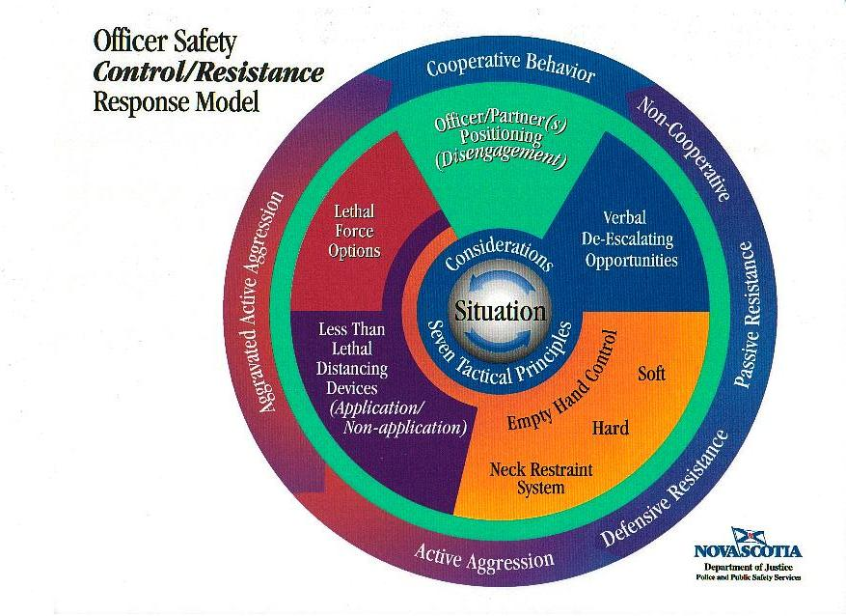
Legal Considerations

Slide 12
Legal Considerations
Personal Weapons are categorized as “Hard Empty Hand techniques”
These are techniques that have a significant chance of:
Bruising
Connective tissue damage
Fractures / breaks (face area, ribs / side area)

Slide 13
Legal Considerations
There are “numerous” variables that can justify the officer using other strikes to various target areas.
Examples:
Officer is spontaneously assaulted by subject.
Subject has weapon – officer does not have time to get to his weapons.
Officer is on the ground.
Multiple assailants, etc.
These are only “four” of many examples where various targets “could” be justified. Remember the “law enforcement officer” is not expected to meet the subjects force presented with parallel force. Rather the “law enforcement officer” is justified to raise the level of force presented by the subject to the level required to “GAIN CONTROL” of the subject given the totality of the circumstances.

Slide 14
Stats
24% of all serious injuries experienced by crime victims were from edged weapns vs. 13% firearms
Fatality rate for officers stabbed is 30% vs. 10% firearms
Canada – 2004 – 33% of all homicides were committed with a knife
Aggravated assaults - 28.7% knife vs. 2.5% firearm

Slide 15
Stuns
The goal of a stun is to:
To physically stop or incapacitate a subject by creating a motor dysfunction.
  over-stimulate motor nerves, temporarily impair muscle(s). May have parasympathetic response
  fluid shock to motor nerve points
  not pain dependent
  lasts 30 seconds to several minutes
  i.e.: charlie horse; hip pointer

Slide 16
Stuns
The goal of a stun is to:
2. To create a high level stun to allow a window of opportunity to facilitate control of a resistive subject.
  overwhelming sensory input that is sudden, intense and unexpected
  lasts approximately 3 – 7 seconds

Slide 17
Striking Techniques
When considering the Use of Force, you must look at:
Is it reasonable based on the level of resistance?
Is force “proportional”?
What would be the extent of the subjects injuries?
Method of de-escalation when control is gained

Slide 18
Striking Techniques
In order to reduce the number of strikes required to control a subject, and limit the injuries to them we utilize two techniques:
Total Body Mass
Fluid Shockwave Principal

Slide 19
Striking Techniques
Total Body Mass
  Use hip rotation
  Strike with the body, not limbs
  Hips give the majority of power
Fluid Shockwave Principal
  Focused strikes
  Allows energy transfer

Slide 20
Summary
We have learned:
  The basic weapons of the body
  Legal considerations of using personal weapons
  Basic strikes and stuns (practical)

